Slide 1
Applications of Kalman Filters to Underwater Navigation

Slide 2
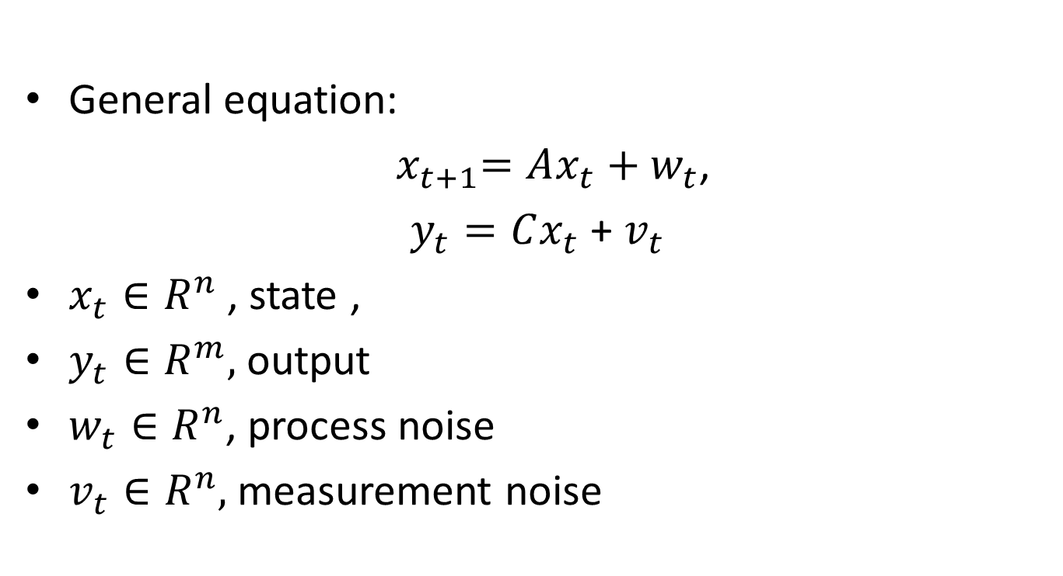
Linear Dynamical Systems
General equation:
${ x}_{t+1}=Ax_{t}+w_{t}$,
$y_{t}=Cx_{t}$ + $v_{t}$
$x_{t}∈R^{n}$ , state ,
$y_{t}∈R^{m},$ output
$w_{t}∈R^{n}$, process noise
$v_{t}∈R^{n},$ measurement noise

Slide 3
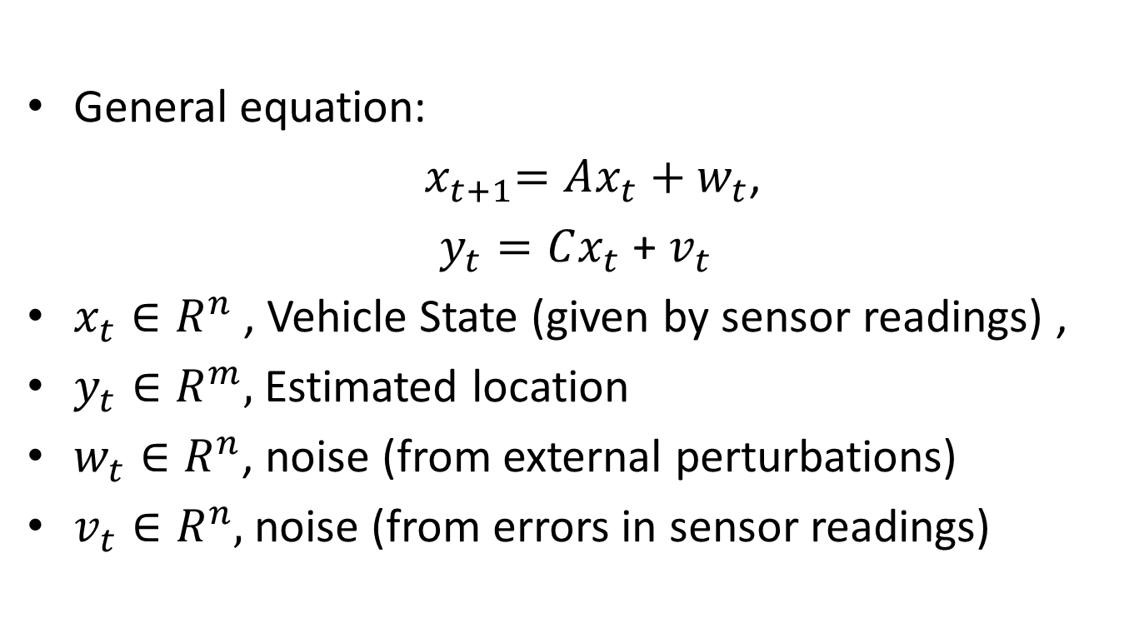
Linear Dynamical Systems (Of UUV)
General equation:
${ x}_{t+1}=Ax_{t}+w_{t}$,
$y_{t}=Cx_{t}$ + $v_{t}$
$x_{t}∈R^{n}$ , Vehicle State (given by sensor readings) ,
$y_{t}∈R^{m},$ Estimated location
$w_{t}∈R^{n}$, noise (from external perturbations)
$v_{t}∈R^{n},$ noise (from errors in sensor readings)

Slide 4
The Kalman Filter
Recursive process of estimation (think newton’s method, markov chains, etc…)
Useful for online estimation given real-time data

Slide 5
Kalman Filter: Why is it special?
If all noise is Gaussian, the Kalman filter minimizes the mean square error of the estimated parameters.
Makes for an optimal noise filtering process
Proof: How detailed to you want it to be?
Source: http://www.swarthmore.edu/NatSci/echeeve1/Ref/Kalman/OptSysKalman.html

Slide 6
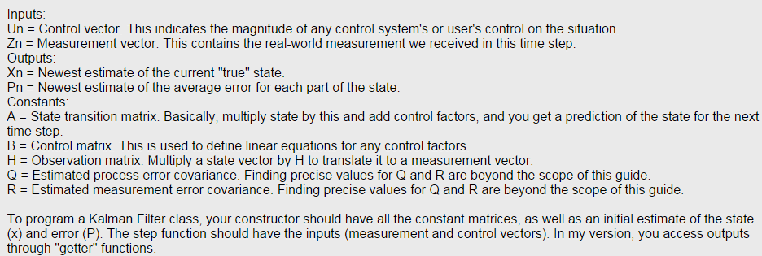
Kalman Filter: Variables
http://greg.czerniak.info/guides/kalman1/

Slide 7
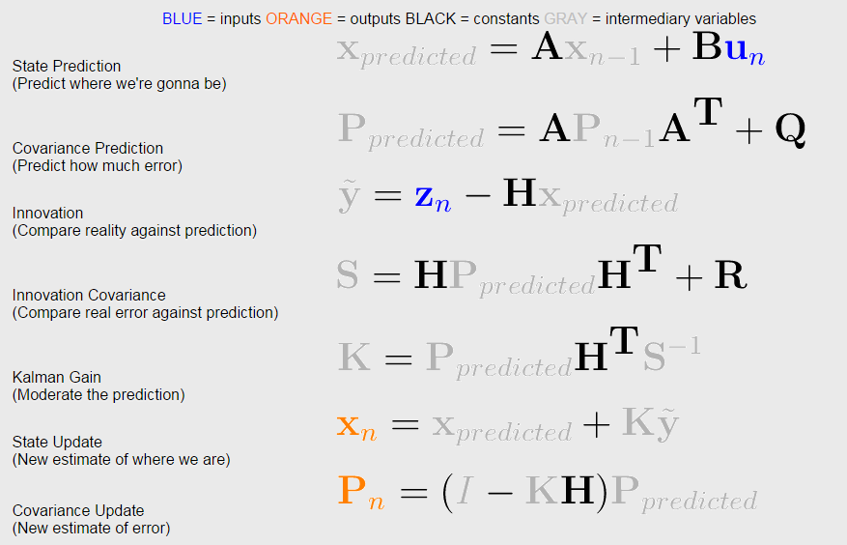
Kalman Filter: Step by Step

Slide 8
Kalman Filter: Example
Ball fired from a cannon
Kalman Filter approximates parabolic curve

Slide 9
So where’s the challenge?
Kalman filter is recursive, thus error propagation is inevitable.
UUV can correct error by surfacing and using GPS tracker
How can we minimize time spent on surface?

Slide 10
Possible solutions
Inertial Navigation uses Taylor expansion to approximate acceleration, velocity, and position
Reduces error at each recursive step
Complexity of increasing approximation by 2 extra terms may polynomial time cost

Slide 11
Possible solutions
Increase sampling rate of Kalman Filter
Allows for linearization of data
Currently supported in Extended Kalman Filter

Slide 12
Still need:
Metric(s) measuring effectiveness of Kalman Filter, without using GPS readings.

